Slide 1
Stroke Prediction
Project 4 Group 6
Caleb Steeves
DJ Thapa
Tanner Victorian
Steffi Yang
Jessica Warner

Slide 2
The Problem
According to the World Health Organization (WHO), stroke is the 2nd leading cause of death globally, responsible for 11% of total deaths.

Slide 3
The Process
Train, Test and Balance Dataset
Clean and Export data
Find Data Set
Import to Spark SQL
Pre-Model Visualizations
Initial NN Models
Optimizing Model
Kaggle: Stroke Prediction
Matplotlib and Seaborn
Finding the model with the best AUC_ROC score

Slide 4
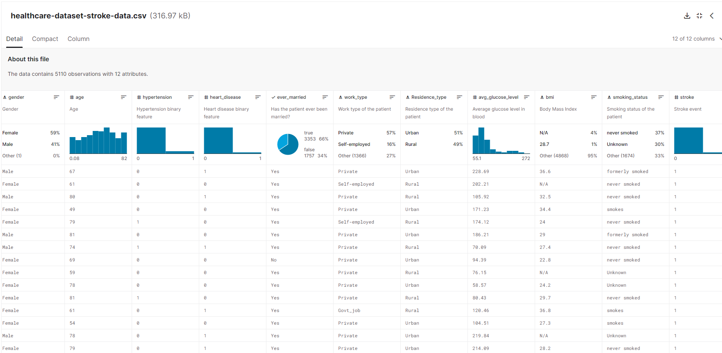
The Data Set

Slide 5
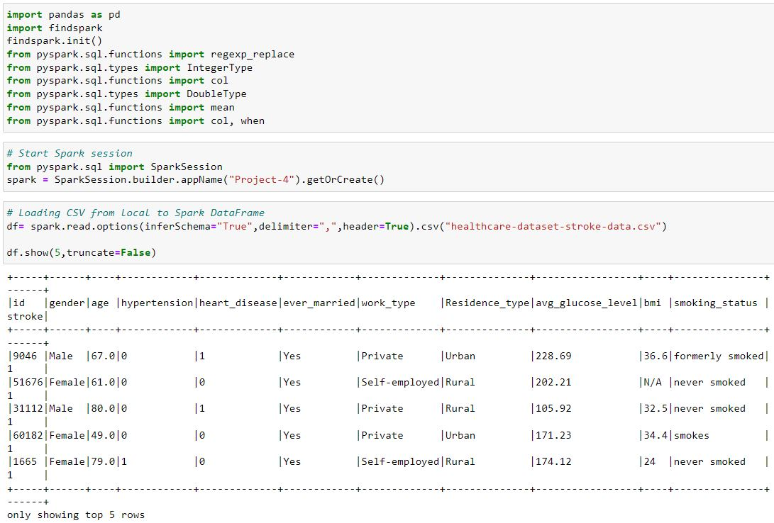
Cleaning and Exporting Data with Spark
Drop ID Column
Change N/A to avg
Extras: Merged Unemployed and Children rows together

Slide 6
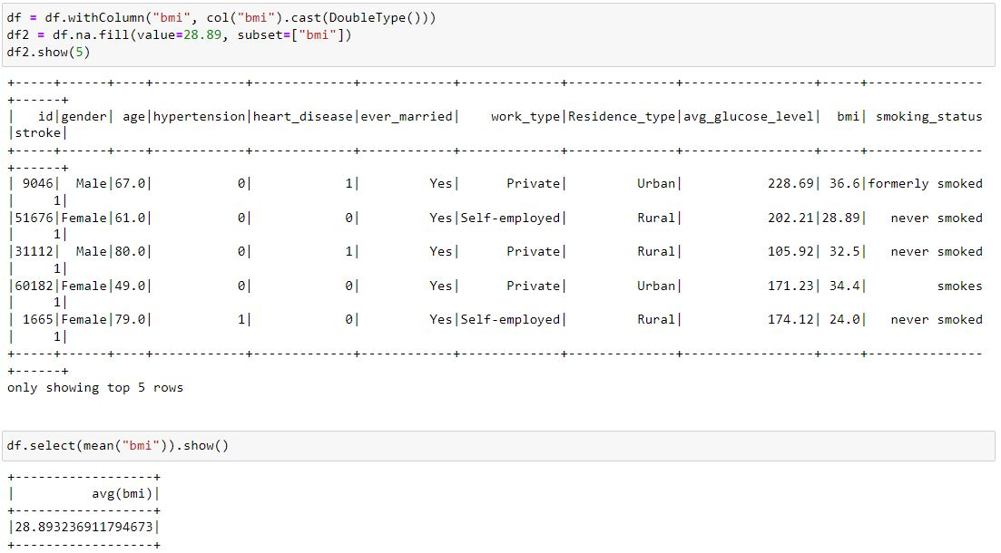
Code to swap n/a for bmi avg=28.89
Fill bmi N/A values with the bmi average of 28.89
code to find avg
* Additional data cleaning methods using Spark can be found in the Appendix.

Slide 7
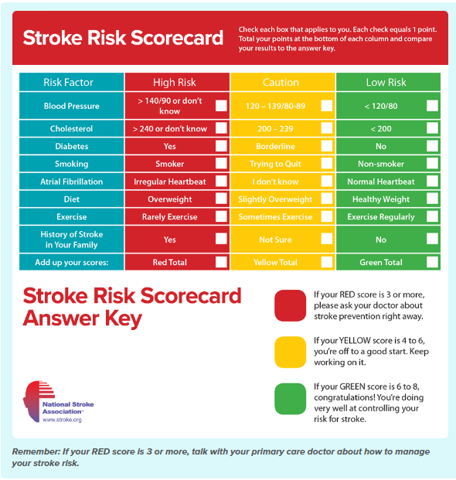
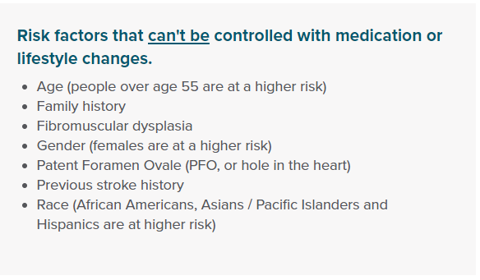
Pre-Model Visualizations
Notes:
To gauge stroke risk, created pre-model visualizations of the dataset. used the Stroke Risk Scorecard from the National Stroke Association and other risk factors mentioned on the website.

Slide 8
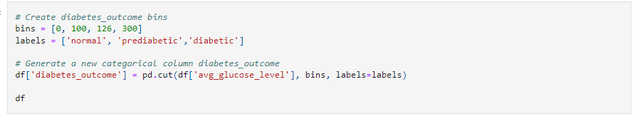
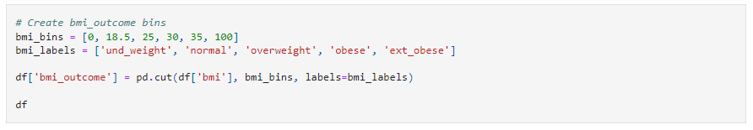
Diabetes and BMI Outcome
Diabetes outcome
BMI outcome
Notes:
After cleaning the data, we noticed it showed general information for each data point, but wasn’t telling us what it meant. We decided to bin the values of diabetes: normal, prediabetic, diabetic and bmi: underweight, normal, overweight, obese, and extremely obese. Making information visually more appealing and understandable for us.

Slide 9
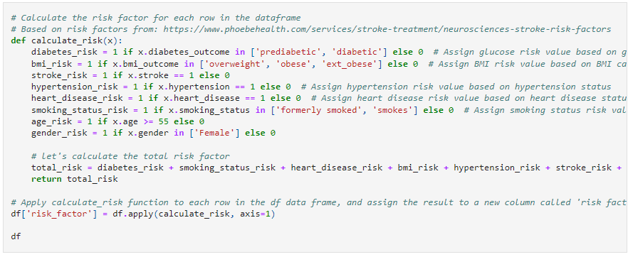
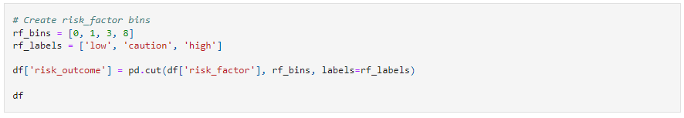
Calculate Risk Factor Score and Outcome
Assign risk factors=1. Find total.
Risk Factor outcome
Notes:
Then we calculated the overall stroke risk score based on the various factors and what was mentioned on the Stroke Risk Scorecard like having diabetes outcome prediabetic, diabetic, bmi overweight, obese, ext obese, stroke, so on so forth. Assigned =1 and totaled to get risk score.
Then, binned in the same manner as diabetes and BMI to determine the outcome: low risk, caution risk, or high risk based on the Stroke Risk Scorecard

Slide 10
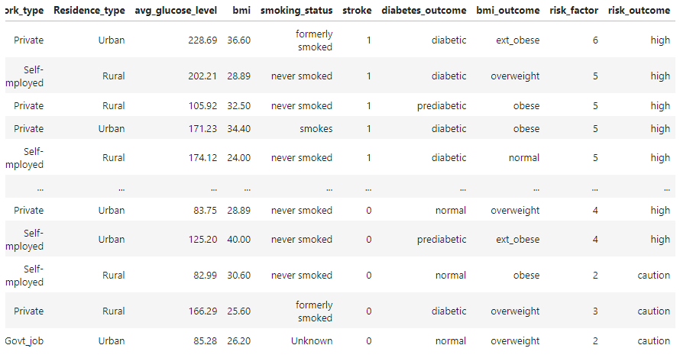
DataFrame with Outcomes
Notes:
Final dataframe with outcomes

Slide 11
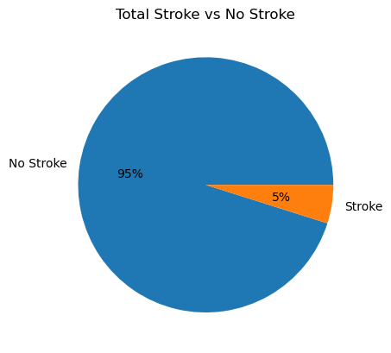
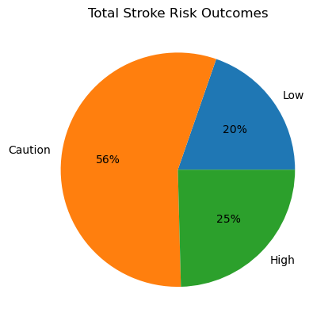
Current Stroke Data
Total No Stroke: 4860
Total Stroke: 249
Low RIsk: 949
Caution Risk: 2686
High Risk: 1185
Notes:
We finally graphed the stroke data which showed only 5% of individuals as having a stroke compared to 95% who indicated No Stroke. However, the high risk outcome of having a stroke was actually 25% with an additional 56% of individuals who were classified as Caution Risk.

Slide 12
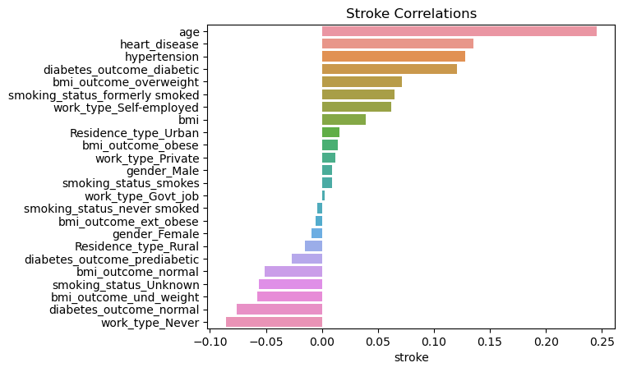
Stroke Correlation
Top 5
Bottom 5
* Stroke correlation charts for heart disease, hypertension, and diabetes can be found in the Appendix.
Notes:
Determined stroke correlation. found the top 5 Stroke Correlations are highlighted here (Age, heart disease, hypertension (high blood pressure), diabetic (high glucose levels), BMI as overweight.)
The bottom 5least correlated to stroke also made perfect sense (like work_type Never, diabetes outcome normal, bmi outcome underweight) = all negative stroke correlation.

Slide 13
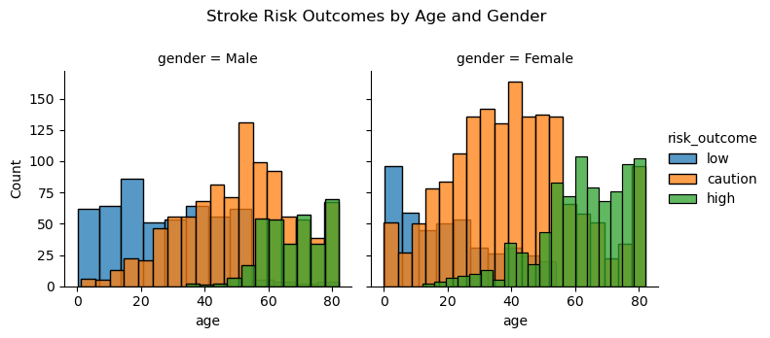
Stroke Correlation: Age and Gender
Total High Risk Males: 331, Average Age: 68
Total High Risk Females: 854, Average Age: 62
Notes:
Diving deeper into each stroke correlation, graphed age and gender as well as age and BMI. Since age had the strongest correlation and gender most easily identifiable, the data did show that females had a much higher risk of stroke compared to males.

Slide 14
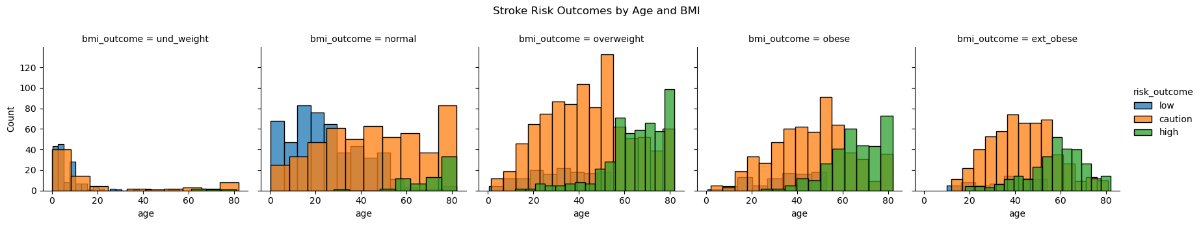
Stroke Correlation: Age and BMI
Total High Risk Overweight: 501, Average Age: 65
Total High Risk Obese: 318, Average Age: 66
Total High Risk Extremely Obese: 294, Average Age: 58
Notes:
For age and BMI, a BMI outcome of overweight, obese, and extremely obese (starting middle chart, moving right) all showed a significant increase of high risk stroke outcome compared to underweight and normal BMIs.

Slide 15
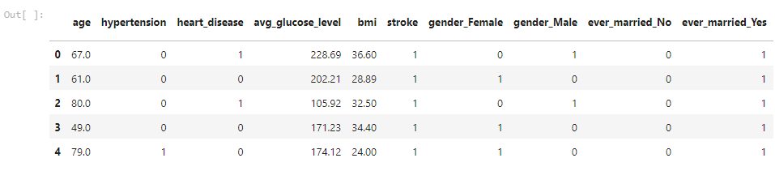
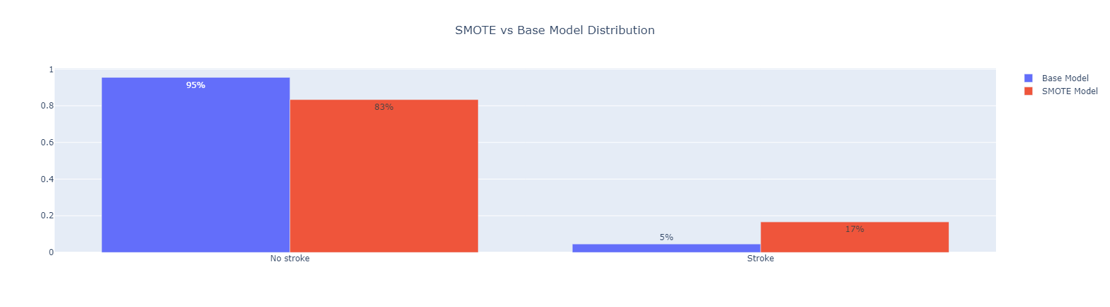
Neural Network - Pre-Processing
Scaling and Balancing Methods
Get_dummies
Data Balancing
SMOTE (Synthetic Minority Oversampling Technique) - Creates synthetic instances of data
Random Under Sampling - randomly selecting data points from majority and dropping
Notes:
Relate how the cleanup led to ease of get_dummies; SMOTE & Random Under Sampling

Slide 16
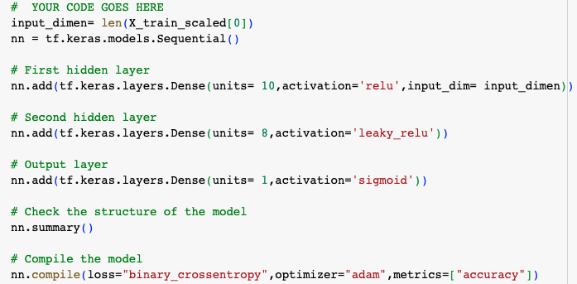
Neural Network- Base model Testing
Finding the best balancing technique
Ran three models with the same architecture
1st Model with unbalanced dataset
2nd Model with the SMOTE technique
3rd Model with Random Under Sampling

Slide 17
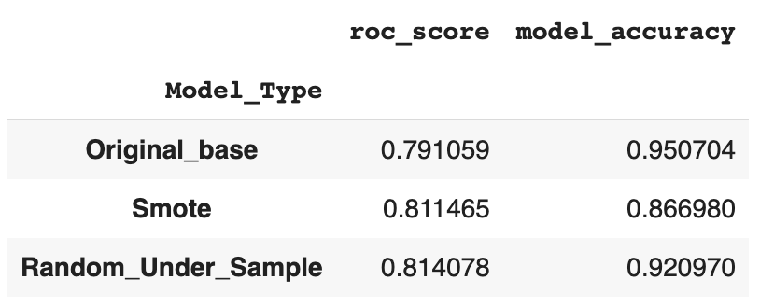
Neural Network- Base model Testing contin…
Scoring balancing techniques with Roc
Accuracy: ratio of correctly predicted observation to total observations
Roc_AUC_Score: Score similar to f1-score where it balances the model’s ability to predict between true positive rates and false positives
Solution: Random Under Sampling

Slide 18
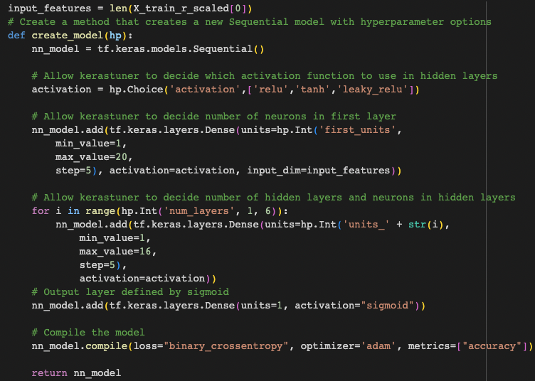
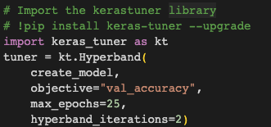

Neural Network - Optimizing Undersampling Model
Using Keras Tuner
Create model architecture
Load Keras Tuner
Generate reports

Slide 19
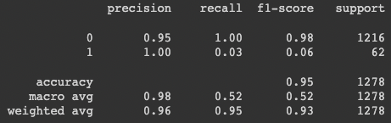

Neural Network - Optimizing Undersampling Model
Tuning to Accuracy
Accuracy score of 95%
Although our model was very accurate, it is very poor at predicting strokes and resulted in many false negatives.
We determined that we wanted a model with the fewest false negatives as possible.

Slide 20

Neural Network - Optimizing Undersampling Model
What is the best metric to tune too?
We began testing a variety of different metrics to tune our model with a goal of decreasing the amount of false negatives.
These include:
Recall
AUC ROC
Precision
Recall at Precision

Slide 21
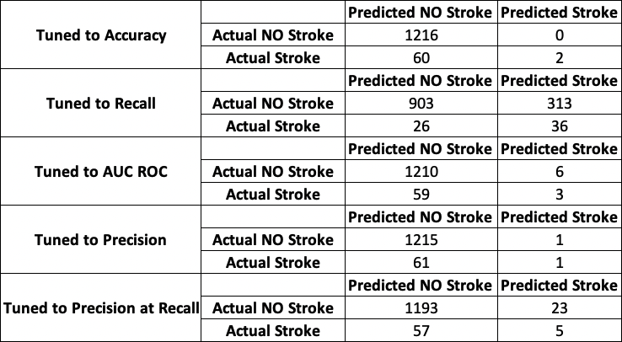
Neural Network - Optimizing Undersampling Model
Confusion Matrices

Slide 22
Neural Network - Optimizing Undersampling Model
Summary
Found the best method for balancing our dataset was Under Sampling
Determined that we cared most about false negatives (predicting no stroke where a stroke actually occurred).
Model that was tuned to Recall produced the fewest false negatives, however it only produced an accuracy of 73%.
We would use this model as a pre-screening to be followed by an examination to determine any false positives.
Through many trials we determined that the best way to optimize this model would be to increase the number of patients with strokes in the dataset.

Slide 23
Appendix
Cleaning with Spark
Stroke Correlation: Age and Heart Disease
Stroke Correlation: Age and Hypertension
Stroke Correlation: Age and Diabetes

Slide 24
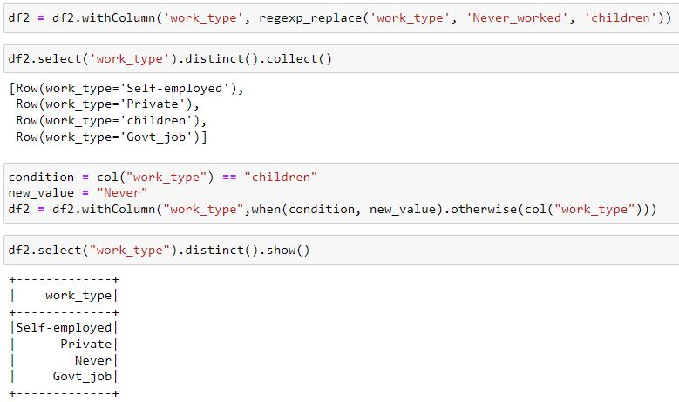
Cleaning with Spark

Slide 25
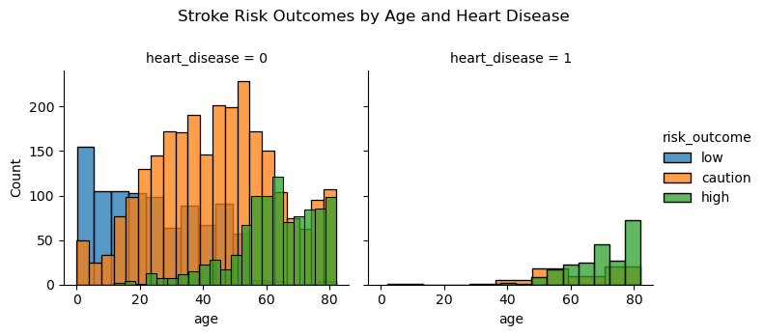
Stroke Correlation: Age and Heart Disease
Total High Risk No Heart Disease: 963, Average Age: 62
Total High Risk Heart Disease: 222, Average Age: 70
Notes:
Those who indicated having heart disease were 80% likely to have a stroke.

Slide 26
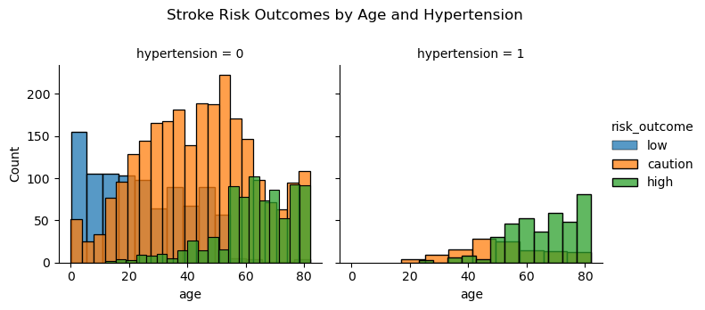
Stroke Correlation: Age and Hypertension
Total High Risk No Hypertension: 811, Average Age: 63
Total High Risk Hypertension: 374, Average Age: 66
Notes:
Those who indicated having hypertension were 75% likely to have a stroke.

Slide 27
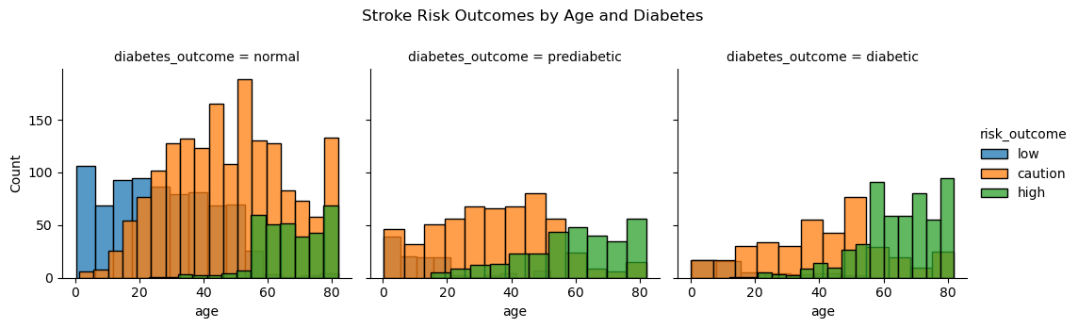
Stroke Correlation: Age and Diabetes
Total High Risk Prediabetic: 308, Average Age: 59
Total High Risk Diabetic: 543, Average Age: 64
Notes:
Prediabetic and Diabetic outcomes were more likely to have a higher possibility of stroke as most individuals were either caution or high risk.

Slide 28
References
https://www.kaggle.com/datasets/fedesoriano/stroke-prediction-dataset
https://www.phoebehealth.com/services/stroke-treatment/neurosciences-stroke-risk-factors
https://seaborn.pydata.org/generated/seaborn.FacetGrid.html

Slide 29
Questions?

